Slide 1
BPM(N) Governance!
Quelle: Camunda via Slideshare.com

Slide 2

StuData
BPM(N)
Methodology and Governance

Slide 3
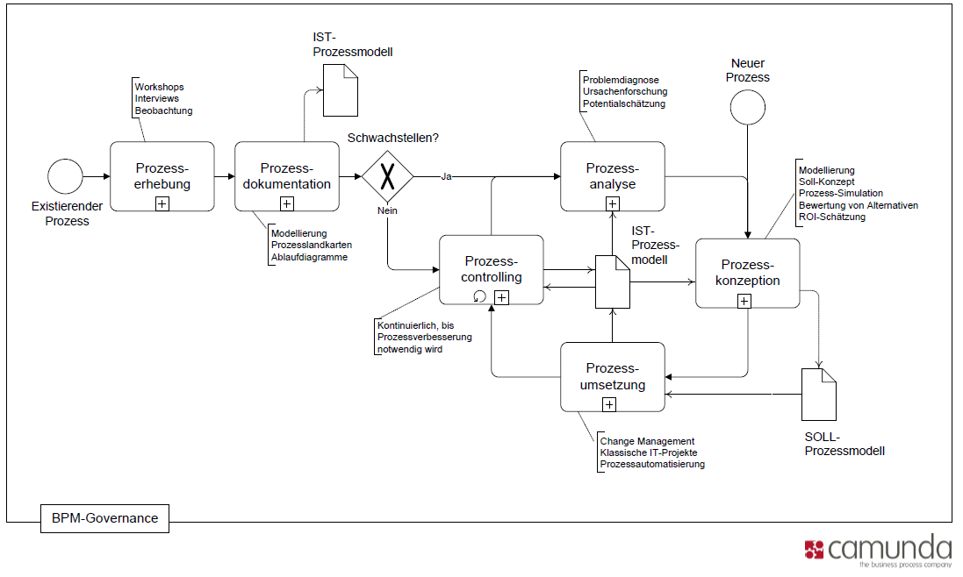
BPM-Kreislauf

Slide 4
Prozessautomatisierung
Kreditantrag geht per Post ein
Scan u. Texterkennung
Process Engine übernimmt el. Dokument
In Aufgabenliste eines Sachbearbeiters
…

Slide 5
Process Engine
Steuert den Prozess
Informiert menschliche Beteiligte
Verarbeitet Ergebnisse der Erledigung (Human Workflow Management)
Ruft IT-Systeme als Services auf (Service Orchestrierung)

Slide 6
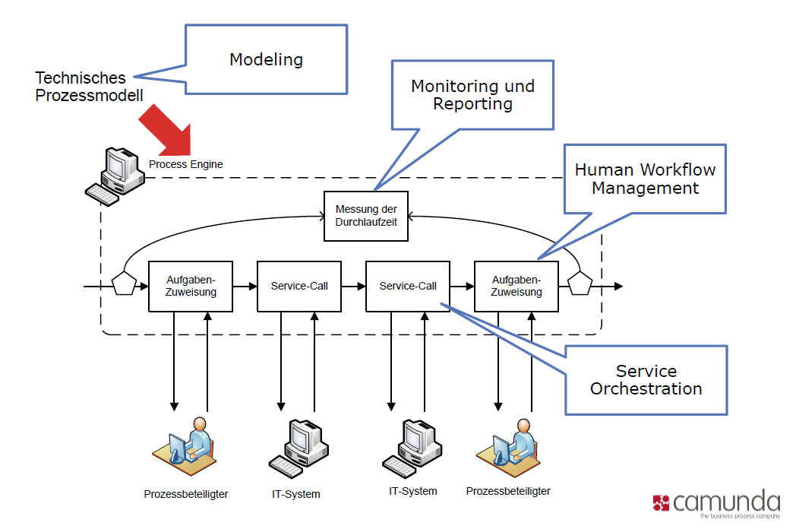
Prozessautomatisierung

Slide 7
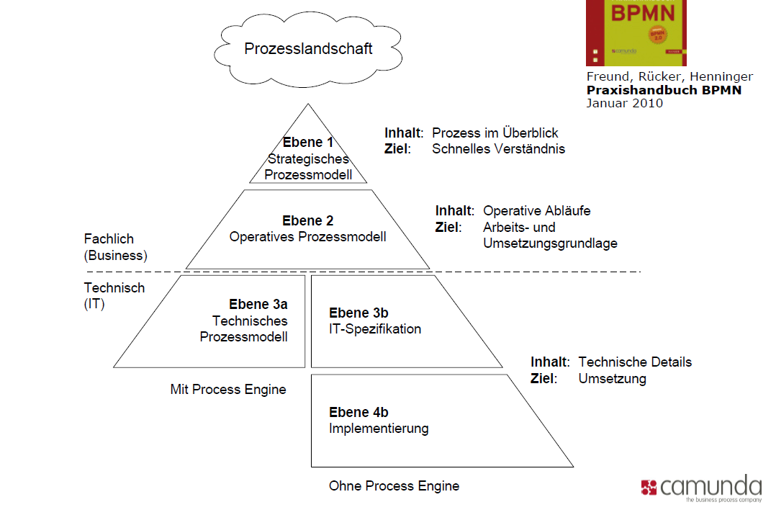
BPM-Framework

Slide 9
StuData
BPM and BPMN

Slide 10
StuData

Slide 12
Example of a chart

Slide 13
Examples of default styles
Text and lines are like this
Hyperlinks like this
Visited hyperlinks like this
Table
Text box
Text box
With shadow

Slide 14
Use of templates
You are free to use these templates for your personal and business presentations.
We have put a lot of work into developing all these templates and retain the copyright in them. They are not Open Source templates. You can use them freely providing that you do not redistribute or sell them.
Do
Use these templates for your presentations
Display your presentation on a web site provided that it is not for the purpose of downloading the template.
If you like these templates, we would always appreciate a link back to our website. Many thanks.
Don’t
Resell or distribute these templates
Put these templates on a website for download. This includes uploading them onto file sharing networks like Slideshare, Myspace, Facebook, bit torrent etc
Pass off any of our created content as your own work
You can find many more free templates on the Presentation Magazine website www.presentationmagazine.com

